Slide 1
Reading at Scale / Voyant

Slide 2
Moretti
“What literature would we find in ‘the large mass of facts’?
What is an event, a cycle, the longue durée
Notes:
A lot of the Moretti chapter is inside baseball. But there are some key concepts that I want you to get at
What does he mean by “large mass of facts”? Get in groups to discuss.
Should be clear that Moretti is talking about literature and science. He’s combing literature with things.
All between pp 13-14
Event for Moretti: the individual case
Cycle: the space between super long and individual – series of isolated events. Unstable structures
Longue durée: the pattern as a whole, the very long, the span of many centuries.
To some extent, he is writing against someone named Ian Watt – wrote a book called The Rise of the Novel.
Rise is a vector going up. Moretti is trying to complicate notions of history. Not just a straight line. Instead you can see ebbs and flows if you look closely enough. Part of the argument is that you need more than just a few points to see these.

Slide 3
What kinds of words do we usually associate with:
Humanities (Literature/History)
Sciences
Notes:
Part of Moretti’s stipulation is that we need to have a different kind of approach to the study of literature / history.
So let’s just think about some words that we might throw up in the two categories here.
Past vs present
Slow vs fast
Small vs big
Ethics vs hope

Slide 4
What kinds of words do we usually associate with:
Literature/History
Sciences
Past
Slow
Ethics
Small
Present
Hope
Fast
Big

Slide 5
What kinds of methods/tools do we usually associate with:
Literature/History
Sciences
Notes:
What about methods and tools? Because we do different things when use each.
Qualitative
Ideas
Writing
Brains
Quantitative
Numbers
Graphs
Computers

Slide 6
What kinds of methods/tools do we usually associate with:
Literature/History
Sciences
Qualitative
Ideas
Writing
Brains
Quantitative
Numbers
Graphs
Computers

Slide 7
Moretti
We read so little of the past.
No one person can read even a fraction of it.
But we need to look at things at scale to get a sense of Literature with a capital L.
Adopting methods from the social sciences can help.
Deeply controversial within literary studies.
Notes:
Some other moretti bits

Slide 8
Digital Humanities
What overlaps or departures can you see with other courses you have taken in other subjects?
Techniques
Subjects
Outcomes
Questions
Notes:
You have some experience in this field called digital humanities now. What overlaps or distinctions can you see with other courses you have taken?

Slide 9
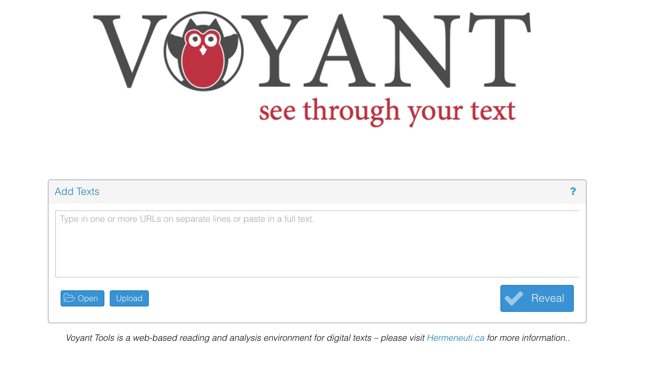
http://voyant-tools.org/
Notes:
We’re going to get into distant reading ourselves. We’ve used google ngrams a bit. Now we’re going to use voyant let’s you upload things yourself. Go to this link – first step.

Slide 10
Visit goo.gl/c00x6s
Copy full text of The String of Pearls into the box
Hit reveal
Will take a bit. If it seems totally frozen, can try a smaller chunk (the reading for today):
goo.gl/1WnXQ1
Notes:
We’re going to need some data. Visit this link.

Slide 11
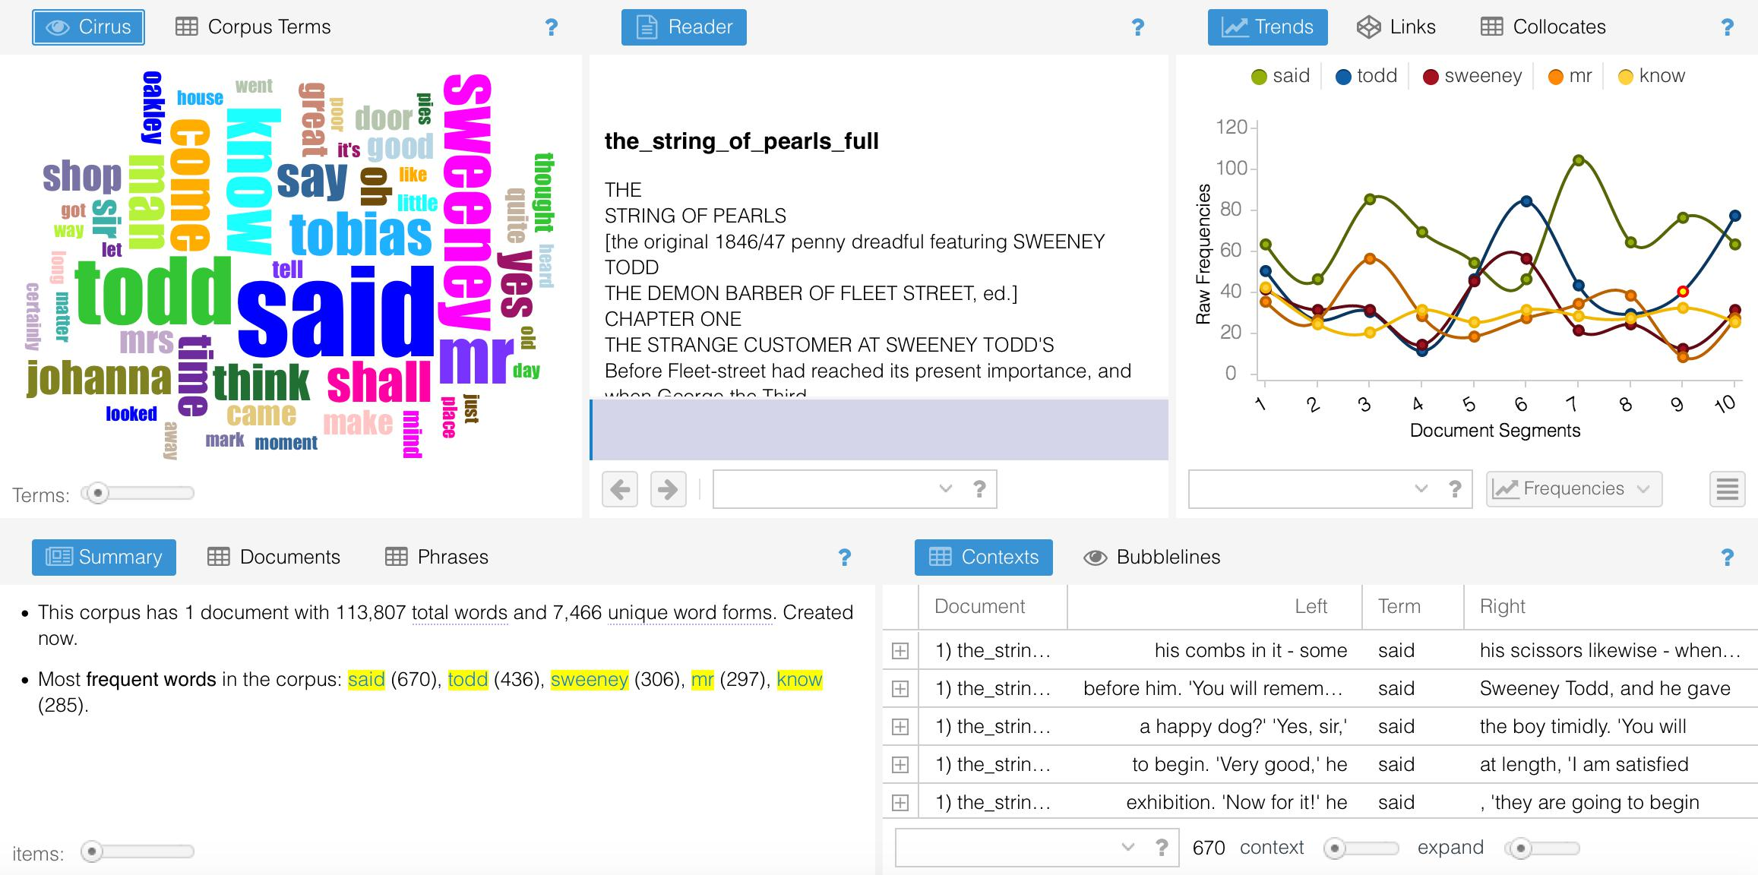
Notes:
We’ll talk a little bit next time about how this process is actually working. Here and for now, we just want to get you into the texts themselves so you can think about them a little bit.
Works well here since you haven’t read the whole thing but you’ve read enough to have thoughts!
You’ll see that Voyant gives you A LOT of different panes for interacting with their information.
In general, if you click on something in one pane it update the things happening in the others.
By default it gives you a look at a bunch of common words.

Slide 12
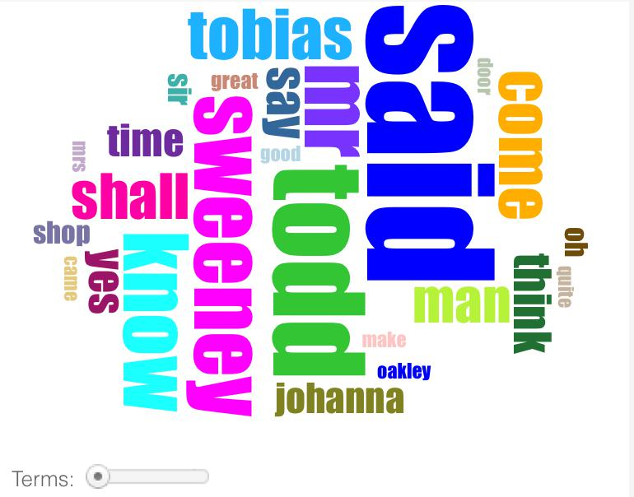
Notes:
What is this? How does it work? Good!
What can we say about this image? Say something interesting. Proper names and said. Compare that to a concept or theme that you noticed while reading.
Anything that people immediately see wrong with it?
Missing a lot of words
Are there any words that you would imagine to be more common?

Slide 13
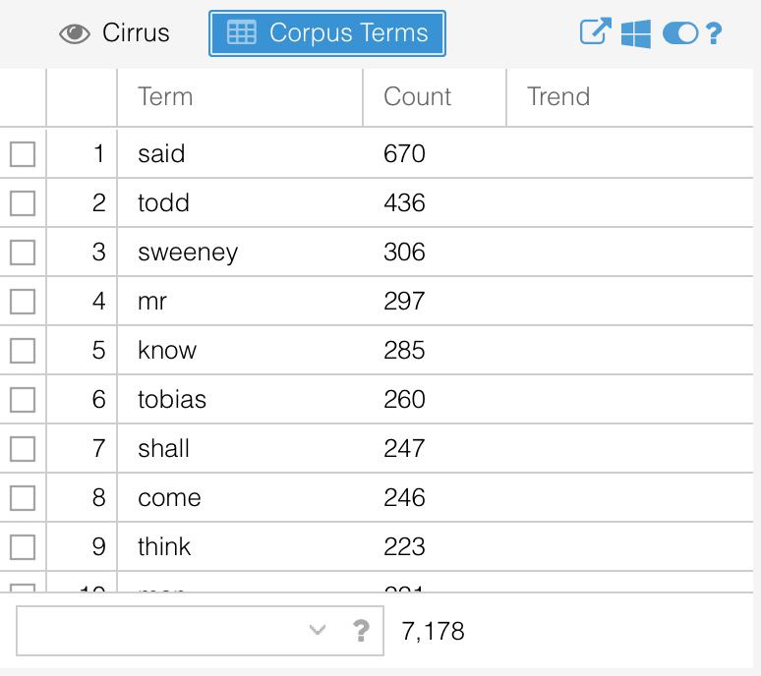
Notes:
Click on ‘corpus terms.’ This is how you can see the underlying data that they’re using.
Word counts like these are, in a certain sense, the basic origin story of digital humanities. Father Roberto Busa was putting together a concordance in the 1990s that took decades using punchcards. We can run similar processes now so easily. And it points to a basic fact – we’re starting to deal with words as numbers. Say something interesting about this. Any problems? There are a bunch of words missing. We can reveal them.

Slide 14
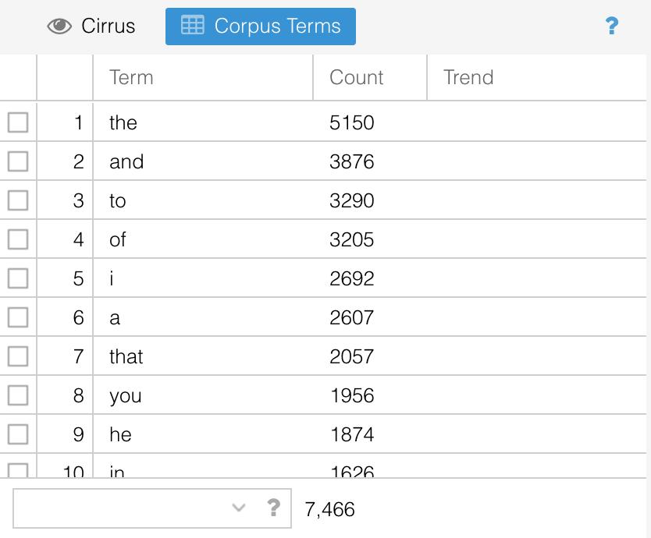

Notes:
If you hover over the question mark, it should expand and you’ll be given a range of options. Click the second option from the right – the sliding option. Select None. You should see some things change! What do you think happened? Stopwords – words that are so common that we usually throw them out! These words are called stopwords. They might not have much meaning. But can you imagine situations in which they might matter?
You can modify this list yourselves! Go back to the list and revert to auto detect. Then go back and click edit list. You can add or remove anything from this list that you want to customize your analysis.
Different languages have their own lists.

Slide 15
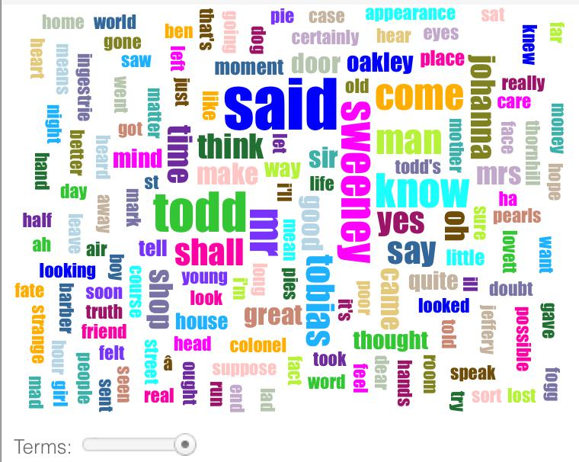
Notes:
This is to say that there are parameters here! That you can change! And find new information about the text. Pull the slider at the bottom to the right. What can you see here? Tell me something.
Note how the visualizations here can change based on the parameters you get. A graph – a visualization. These things are not truth. They are made you. Think critically about them and their construction.

Slide 16
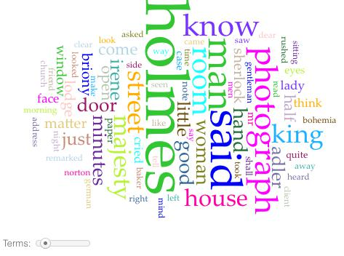
Notes:
One more visualization. You’ve read the sherlock holmes story. What can this tell you about the text? Don’t need to be able to manipulate to be able to do this! What different things can we say about these stories? How can we compare them?

Slide 17
Exporting
Screenshots
Other options:
Left-most option can give you a URL or a code snippet to embed elsewhere.

Slide 18
Remaining Time
Take a few minutes
Find some interesting things in the text by playing around.
Feel free to move beyond the word clouds.
Come back and we will discuss.

